Slide 1
Maturity Model for Microsoft 365 Practitioners
Collaboration Competency
October 2021
⭐ Guest star ⭐ Susan Hanley| @SusanHanley
Marc Anderson, Sympraxis Consulting | @sympmarc
Simon Doy, iThink 365 | @simondoy
Simon Hudson, Novia Consulting | @simonjhudson
Sharon Weaver, Smarter Consulting | @sharoneweaver
Initiative started by Sadie Van Buren as the SharePoint Maturity Model in 2010
Notes:
Simon D

Slide 2


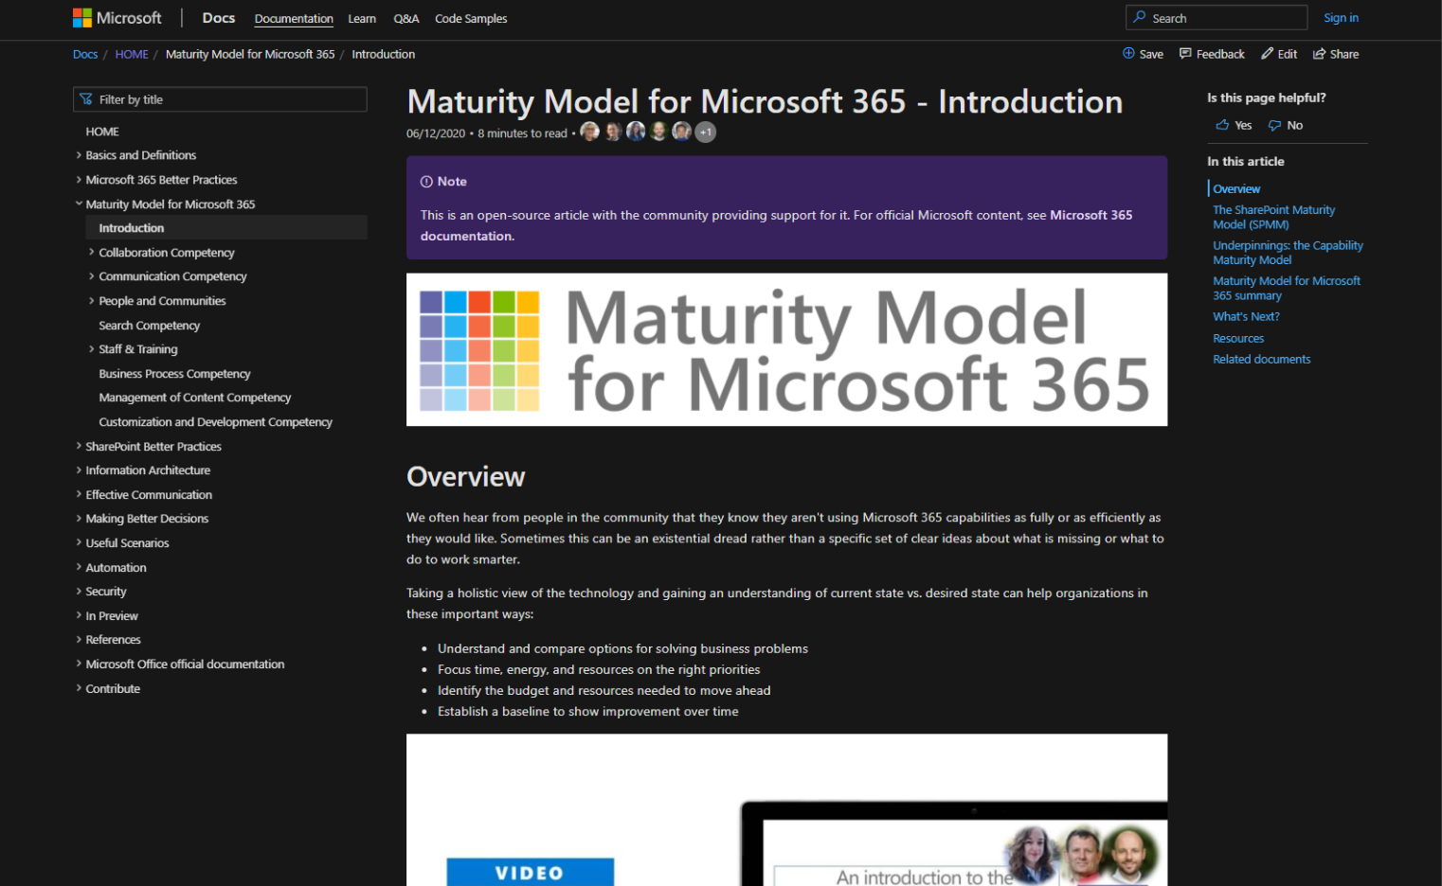
v
Agenda
Practitioner & Maturity Model overview
Artifacts and Updates
Purpose
How to get more involved
Shout-out & Picture Time (Together Mode!)
Discussion with our rockstar of the day: Collaboration Competency
Notes:
Simon D

Slide 3

The approach and articles on Microsoft Docs
Artefacts
Improve organization through use of technology
Benchmark company and department
Select appropriate approach
Develop an organizational business and technical roadmap based on:
What's possible
What's desired
Organization's culture and drivers
Lead and support strategic planning, with senior management
Align implementation needs and objectives
Discuss use of the platform with IT – not just technology
Socialization tool
PURPOSE
Published Competencies
Supporting Articles
Business Process
Running a MM4M365 workshop
Principles of…
Collaboration
Practitioner meeting recordings
Search
Communication
Communication
Open Competencies
Management of Content
How to elevate…
In progress
People & Communities
Infrastructure
Collaboration
Search
To do
Communication
Security…
Staff & Training
People & Communities
Customization & Development
Data & Analytics
Staff & Training

Slide 4
MM4M365 provides benchmarks to measure your organization
Maturity Level | Description | Intent
Level 500 Optimizing | Deliberate and systematic process improvement/optimization Focus is on continually improving process performance Addressing statistical common causes of process variation and iterative process improvement | Optimal, systematic, statistical, improvement-focus, automated, assured, proactive
Level 400 Predictable | Actively managed in accordance with agreed processes and has tracked metrics Effective achievement can be evidenced across a range of operational conditions Process has been tested and refined Process users demonstrate competence | Productive, interactive, responsive, enhanced, effective, adaptable, quality
Level 300 Defined | Defined and standardized Signed off, managed process Limited validation of effectiveness, doesn’t include edge cases Process users demonstrate familiarity | Documented, policy-driven, planned, controlled, stable
Level 200 Managed | Key processes defined but not standardized, uniformly or strongly applied Some ability to demonstrate consistent outcomes Limited buy-in from staff and management Widespread inconsistency and resistance | Routine, legacy, fire-fighting, variable, personally managed
Level 100 Initial | Default, starting/exploratory state People driven processes, lacking documentation and discipline Many ways of doing the same thing (with variable results) Characterised by inefficient legacy approaches and pockets of unmanaged innovation | Ad hoc, reactive, uncontrolled, chaotic, unstable, not designed

Slide 5
MM4M365 – Intention at each level
Maturity Level | Description | Intent
Level 500 Optimizing | Deliberate and systematic process improvement/optimization Focus is on continually improving process performance Addressing statistical common causes of process variation and iterative process improvement | “We want to ensure all the key processes are always effective and resilient, while designing the same into anything new we do”
Level 400 Predictable | Actively managed in accordance with agreed processes and has tracked metrics Effective achievement can be evidenced across a range of operational conditions Process has been tested and refined Process users demonstrate competence | “Let’s make things even better by measuring, analyzing and taking actions to improve based on that“
Level 300 Defined | Defined and standardized Signed off, managed process Limited validation of effectiveness, doesn’t include edge cases Process users demonstrate familiarity | “We have defined our processes, policies and procedures, everyone seems to be doing the right thing; let’s keep doing that”
Level 200 Managed | Key processes defined but not standardized, uniformly or strongly applied Some ability to demonstrate consistent outcomes Limited buy-in from staff and management Widespread inconsistency and resistance | “We should ensure everyone knows what they should be doing”
Level 100 Initial | Default, starting/exploratory state People driven processes, lacking documentation and discipline Many ways of doing the same thing (with variable results) Characterised by inefficient legacy approaches and pockets of unmanaged innovation | “Let’s keep putting the fires out and keep the lights on!”

Slide 6
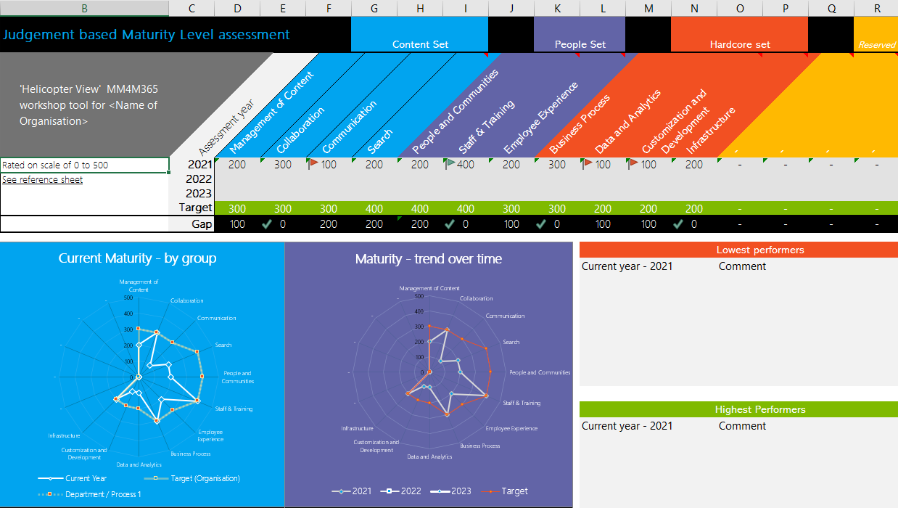
Purpose
Discussion-based monthly meeting
Highlights of new assets
Understanding the competencies
Mapping technology to maturity levels and competencies
Running a workshop
Measuring maturity
Sharing anecdotes and success stories
Feedback on the maturity model
Safe space to hone your pitch, test your thoughts, or decide how to promote your use of the Maturity Model
OVERVIEW
Practitioners for
Maturity Model
for Microsoft 365
Get Involved
https://aka.ms/sharing-is-caring
Present case study (at MM4M365 Practitioners or other speaking opportunities)
Contribute on GitHub
Provide feedback, insights, tools, and artifacts
Socialize
content
Run a MM4M365 workshop
https://symp.info/MM4M365Workshop
Recordings
http://mmvideos.m365.ms/

Slide 7
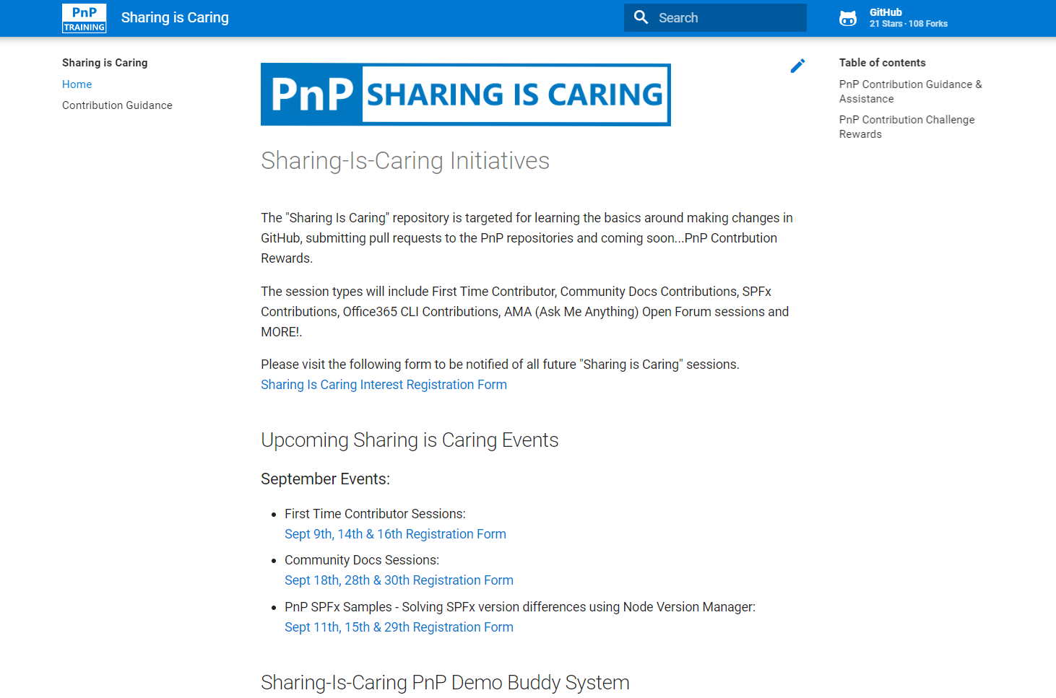

GUIDANCE
Get started on the open-source and community work?
Community Docs Sessions
Wednesday, 17th November, 7am PST
First Time Contributor Sessions
Wednesday, 3rd November, 7am PST
Thank you, September attendees
Alistair Pugin
Andrew Burns
Bob Morris
Caleb Miller
Chris Graves
Chris Revell
Chris Sparrow
Christian Jacob
Curtis Scheer
Dale Pilarczyk
Daniel Westerdale
David Warner II
Edris Kakembo
Georges Clément Kouassi
Henrik Yllemo
Jason Lambiris
Jennifer Erzen
Joe Gasper
Joni Jackson
Katrin Rannaste
Linda Delarvé
Logesh Rammohan
Manjunath Siddappa
Marc Anderson
Michael Markett
Mike Duffy
Muralidharan Deenathayalan
Nanddeep Nachan
Nicole J Fleming
Paul Bullock
Pete Simpkins
Ralph Rivas
Rob Bell
Rocio Holub
Sabrina Faragoza
Sean Garvin
Simon Doy
Simon Hudson
Simon Thompson
Stefan Cremer
Tara Saylor
Tim Balk
Tony Derricott
Tora Grufstedt
Next MM4M365 call
November 16th at 7:00am PST
Topic: Search
Third Tuesday of every month
https://aka.ms/sharing-is-caring
https://aka.ms/sharing-is-caring

Slide 8
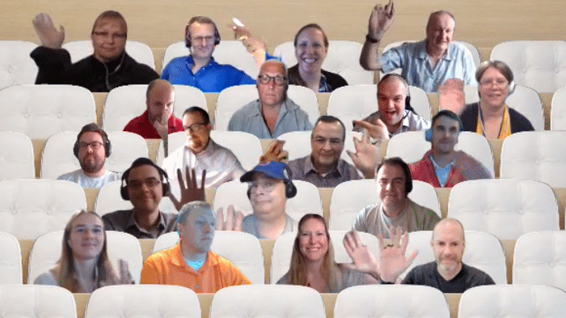

PnP Picture Time!
Please turn your video on
we’ll grab a Together Mode pic with everyone who wants to be seen to be here.
We are together in this as a community!
September 2021

Slide 9



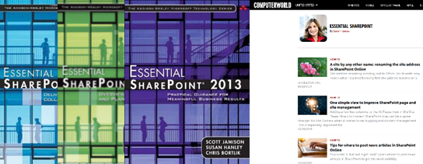

How I became a collaboration nerd
Degrees in Psychology and Information Systems Management
Director of Knowledge Management at American Management Systems
Portals and Collaboration Practice Lead for Dell Professional Services
Independent consultant since 2005 – all intranets, KM, and collaboration all the time
"Mimi" to Hannah
Notes:
Introduce Tara - Simon D

Slide 10

DISCUSSION
Collaboration Competency
PROTOCOL
Visually emote and support Share reactions while others are speaking
Come off mute and share your thoughts
Share your camera (don’t be shy)
Raise your hand to say your piece (and put it down again!)
Notes:
Simon D – introduction and introduce our rock star presenter

Slide 11





Conversation and Collaboration Modes
Type
Example
Try this …
Quick, transitive, low importance
“Want to grab a sandwich?
"Which sandwich shop should we order from for the department from now on?"
Making decisions, group think
External, formal
“We’d like to work on a sandwich with you.”
Seeking help, crowdsourcing
“Who knows about sandwiches?”
Strategic
“NDA: We’re planning to start a sandwiches division.”
Informational, inspirational
“We see that sandwiches are trending up.”
Personal, confidential
“We’re firing the sandwich guy – YOU!”
Notes:
Thank Marc Anderson

Slide 12
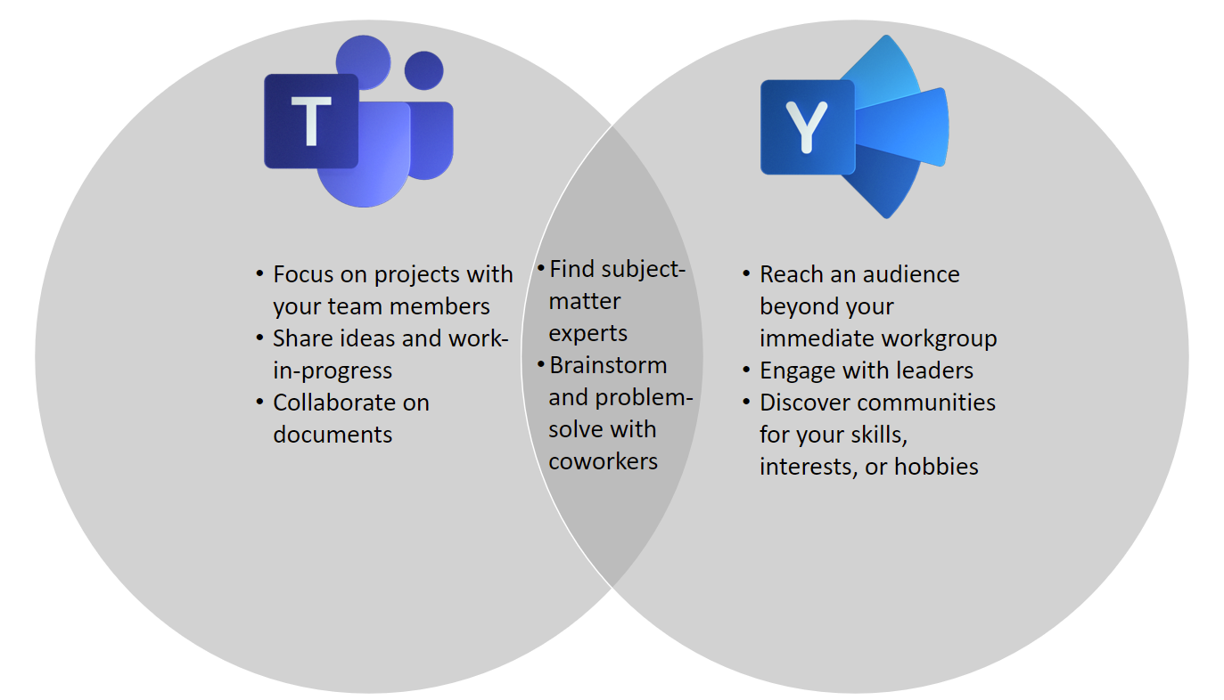

Slide 13
Some thoughts
What are the outcomes we want?
How are we doing against those outcomes today?
What techniques can we use to improve our outcomes?
What are the benefits of being at this level? What outcomes do we get by being at this level?
Anecdote: leaders in Europe refused to reply to email with attachments
Execs need to demonstrate and reinforce the behaviors they have asked the org to use
Top down / bottom up – T shaped managers; highly respected thought leaders
Culture and processes
Recognize and reward people for innovation and reuse
Build in time to find instances of doing this before up front and capture learnings at the end
“We don’t have time for…”
Real time collaboration vs long term KM
Collaboration is people
Good communication is part of collaboration
Email standards
Content organization DURING teamwork can lead to capture of the right artifacts at teamwork end
Viva Topics – not perfect, need manual curation

Slide 14
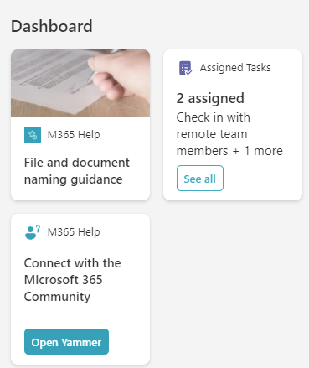
Viva
Viva Topics
Brand new
Requires manual curation
Task Management
Viva Connections dashboard – task cards
Project startup card
Checklist for project initiation (Future)
File naming guidance
Feed currently broken
Only works on desktop and phone (no tablet until 22Q1)

Slide 15
The Process of collaboration vs. The Culture of collaboration
Most organizations think they have reached the end of the journey at Level 3.

Slide 16
MM4M365 – Intention at level 100
Maturity Level | Description | Intent
Level 100 Initial | No formality in how to collaborate No structure of process for site requests, structure and naming. Staff and owners not trained. While links can be emailed rather than the documents themselves, copies of documents still get attached to emails. Collaboration happens “all over the place” | “I don’t think about how I work with colleagues; I just use whatever I know, or they suggest”

Slide 17
MM4M365 – Intention at level 200
Maturity Level | Description | Intent
Level 200 Managed | Process Agreeing not to send attachments Introducing File naming conventions Some mechanisms are in place for new site requests, default settings are used (incl for external access). Collaboration efforts occur in document libraries, co-authoring & versioning in use. Some use of basic metadata (status, dates etc). Training and knowledge are inconsistent. Culture Recognition that collaboration needs to happen | “We are mostly using the same platform, recognize some of the power, but aren’t taking it to the next level”

Slide 18
MM4M365 – Intention at level 300
Maturity Level | Description | Intent
Level 300 Defined | Process Templates enable better practices Processes exist to manage site and content lifecycles, external access, document status, ownership, task allocation etc. Teams are able to determine their own style of collaboration; this is defined in policy and procedure Consistent terminology and formats support collective activities. Collaboration extends beyond documents and is supported by other apps and features. Culture Discussions, meetings and actions are wrapped around collaboration activities. Collaboration is enabled and encouraged within projects etc. | “We have defined our processes, policies and procedures, everyone seems to be collaborating the right way; let’s keep doing that”
Notes:
Are successful at the process of collaboration.

Slide 19
MM4M365 – Intention at level 400
Maturity Level | Description | Intent
Level 400 Predictable | Culture The culture is collaborative – empowerment, trust and permission Tacit knowledge is transferred through departments and roles Continuously improving templates based on usage statistics Collaboration is understood beyond task-based activities Process Collaboration is governed and compliant. Collaboration supports line of business systems. Diary management is well-established, and availability for collaborative work is managed (including real-time presence and ‘focus’ time slots). Asynchronous collaboration is facilitated by features (e.g. @mentions) that signpost colleagues to content and actions, ensuring notifications are productive rather than interruptions. Productivity and other collaboration metrics provide insights. Opportunities for informal conversations are actively created (water-cooler conversations), especially within disciplines | “We want to learn how to collaborate better and understand who does it well within our organization. This enables us to be better“
Notes:
It’s no longer just about getting the job done. We are now using opportunities and experiences to enhance our collaboration/tacit knowledge. No longer task focused, but using non-traditional ways to encourage and empower shared knowledge and experience.

Slide 20
MM4M365 – Intention at level 500
Maturity Level | Description | Intent
Level 500 Optimizing | Culture Collaboration is baked into the culture. Staff are expected to do non-traditional/non-task collaboration Deep collaboration enabled through cross-skilling, placements and multi-disciplinary meetings. Informal and formal knowledge transfer are designed into the organizational culture (water-cooler conversations) across disciplines. No one needs an excuse to collaborate. Process Metrics are used to measure and improve collaboration outcomes, clearly connected to strategy. Automation enables and protects collaborative efforts, in line with understood policies. Downstream collaboration processes are automated & optimised. Staff are accountable for tasks and commitments; with feedback used to assure productivity. Collaboration processes and benefits extend to external partners. | “We want to ensure collaboration is always effective and safe, regardless of who, what and where”
Notes:
Create opportunities within departments and across the organization to collaborate for shared experiences. Longer term (multi-week/multi-month) enterprise, cross functional, collaborative projects to solve a problem or discuss a specific topic.
It takes a highly mature company to pull hourly staff off the task and engage them in non-task collaboration.

Slide 21
A few resources
https://www.computerworld.com/article/2221091/sharepoint-user-adoption-strategy--team-member--service-level-agreement
https://sway.office.com/tewankw51rkJ0E2w?ref=Link%2f
The Hamster Revolution: How to Manage Your Email Before It Manages You eBook : Song, Mike, Halsey, Vicki, Burress, Tim: Kindle Store
Matt Wade's Definitive Guide To Teams Etiquette (avepoint.com)

Slide 22
Q&A Recording off!

Slide 23
Future topics
Search
Business process
Data & Analytics
Accessibility & the Maturity Model
Infrastructure

Slide 24

Thank you
Follow us on Twitter
@M365Maturity | @M365CommDocs
Take the Maturity Model Self-Assessment: https://symp.info/MM4M365-SelfAssessment
Fill out the Maturity Model Survey: https://symp.info/MM4M365Survey
Discussions in Github: https://symp.info/MM4M365Discussion
YouTube: https://symp.info/MM4M365Videos
Slide decks: https://symp.info/MM4M365Slides
Next MM4M365 monthly call: Nov 16th 10am ET / 7am PT
Third Tuesday of every month
https://aka.ms/sharing-is-caring

Slide 25


aka.ms/m365pnp

